Slide 1
DIGITAL NATURALIST USING IBM WATSON STUDIO
TEAM: TEAM5
MEMBERS:
B.Manasa Reddy-19MIA1009
Nagaruru Shreya-19MIA1044
Sanjana Alaham-19MIA1055
K.Harshitha-19MIA1026
P.Sanjana Reddy-19BCE1581

Slide 2
INTRODUCTION
In our world, there are various species. Some species are being found rarely and if found also prediction becomes very difficult. In order to overcome this problem, we have an effective and simple way to recognize these species based on their features. Also, the human ability to recognize the birds through the images is more understandable than audio recognition. So, we have used Convolutional Neural Networks (CNN). CNN’s are the strong assemblage of machine learning which have proven efficient in image processing.
In this project, we are creating a web application which uses a deep learning model, trained on different species of birds, flowers and mammals and get the prediction of the bird when an image is being given.

Slide 3
PROBLEM STATEMENT
This project focuses on detection of different species of birds,flowers and mammals and obtaining images of that particular category (birds,flowers,mammals) when an image is given.
The app that we are developing would be very helpful to all the field naturalists as field naturalists can use this web app from anywhere to identify the birds, flowers, mammals and other species they see on their hikes, canoe trips and other excursions.

Slide 4
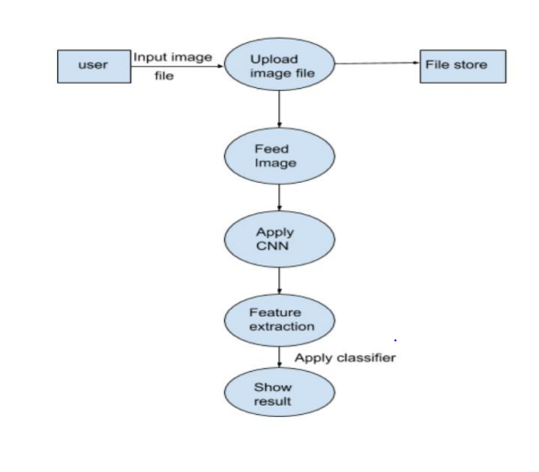
FLOW CHART

Slide 5
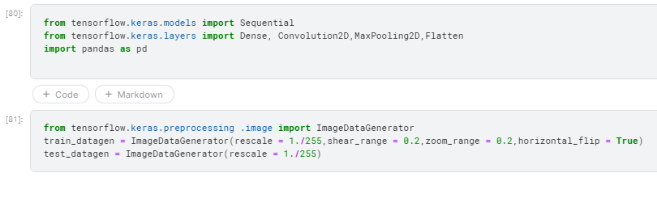
IMPORTING LIBRARIES AND DATA AUGMENTATION

Slide 6
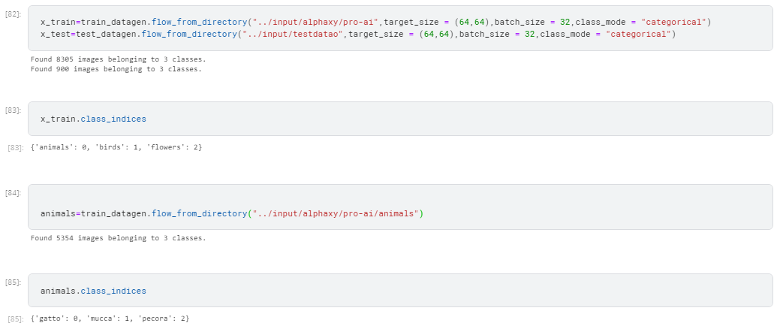
PREPROCESSING

Slide 7
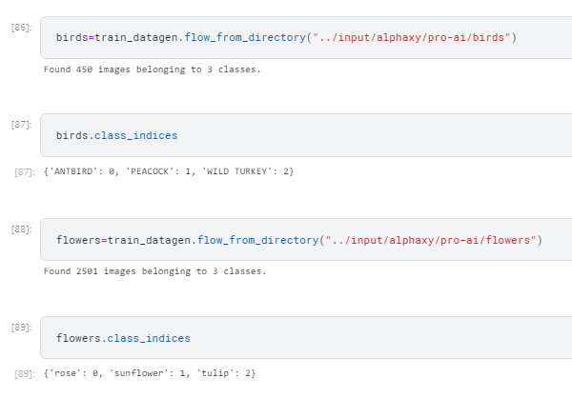
Cont...

Slide 8
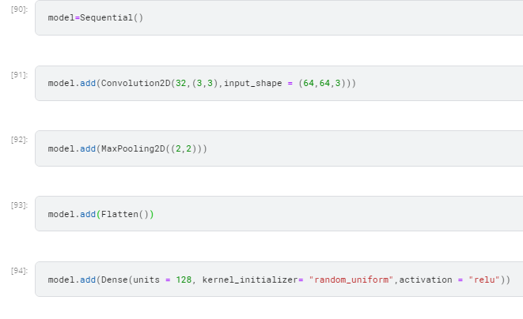
MODEL BUILDING : ADDING INPUT ,HIDDEN LAYER

Slide 9
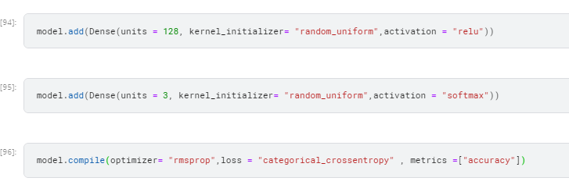
ADDING HIDDEN &OUTPUT LAYERS
COMPILING THE MODEL

Slide 10
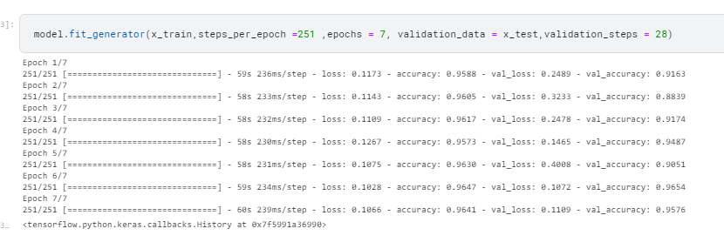
MODEL FITTING

Slide 11

SAVING MODEL

Slide 12
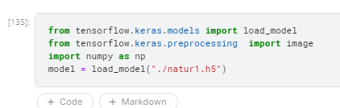
IMPORTING LIBRARIES FOR TESTING

Slide 13
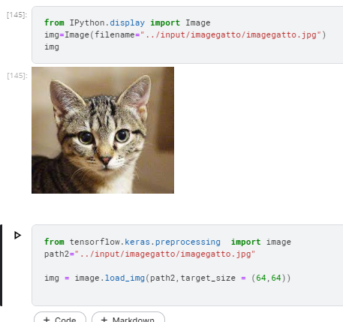
IMPORTING IMAGE AND PREPROCESSING IMAGE

Slide 14
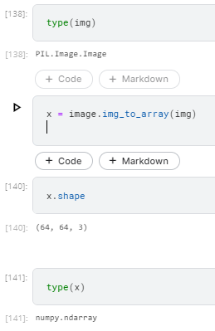
CONVERTING IMAGE TO ARRAY

Slide 15
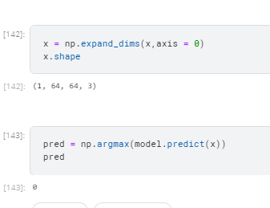
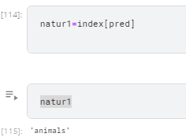
PREDICTING IMAGES

Slide 16
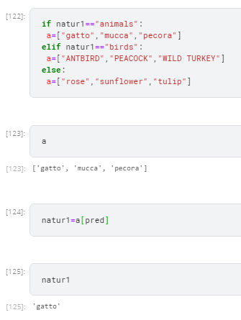
PREDICTING SUBCLASSES

